Slide 1
A mega project on
Animal Detection To Avoid Collision Using Machine Learning (YOLO algorithm)
Under Guidance of
Prof. Y. M. Kamble

Slide 2
Group members
Ms. Pranita Giri 15cmpn08
Ms. Shraddha Karadge 15cmpn20
Ms. Priyanka Khot 15cmpn24
Ms. Shraddha Rhatole 15cmpn47
Ms. Jyoti Shinde 15cmpn51

Slide 3
Index
Introduction
Literature Review
Problem Statement
Objectives
Proposed Work
System Architecture
Methodology & Implementation
Software System Requirements

Slide 4
Introduction
Today’s automobile design primarily depends on safety measures, security tools and comfort mechanism. The safety of an automobile is the highest priority. A major percentage of these road crashes and accidents involved cars, other vehicles and animal collision.
So there is one approach to overcome this issue. Also there are some papers in which animals are detected using roadside system and for night vision and also for moose detection system.
The proposed system is to develop a practical animal detection system used to reduce the number of road accidents due to animal collision. This system will be applicable in real time for security purpose of wildlife and human being.

Slide 5
LiterAture Review
A recent study shown that human beings have to take the final call while driving whether they can control their car to prevent collision with a response time of 150ms or no.
The scientific researchers have proposed a method that requires the animals to take a pose towards the camera for the trigger, including face detection.
Recent researches also revealed that it 's hard to decide the threshold value as the background changes often.

Slide 6
Problem Statement
To design and develop a system to find animals around the vehicle in motion using YOLO algorithm.

Slide 7
OBJECTIVES
To get the features of the animal by using feature extraction technique.
To develop a low-cost automatic animal detection system.
To implement a system used to avoid the animal-vehicle collision by using object detection.
To enhance a security of animals as well as human being.

Slide 8
Proposed Work
First of all the system will capture the input video in short interval of time. Then it will generate frames from the input video.
Then the system will construct blob from input frame giving bounding boxes and associated probabilities.
It will extract the class ID and probability of the current object.
Then it draw a bounding box rectangle and label on the frame and the object is detected.

Slide 9
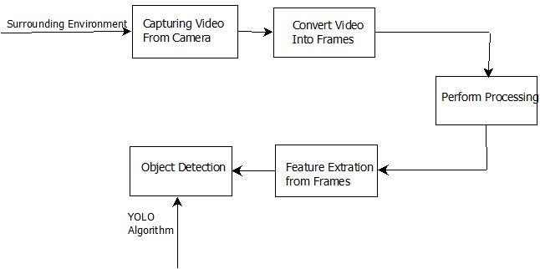
SYSTEM ARCHITECTURE

Slide 10
METHODOLOGY & IMPLEMENTATION
Input: Any video.
The COCO class labels are loaded which is trained on YOLO model.
Then YOLO object detector is loaded which is trained COCO dataset which consists of 80 classes.
Video will converted into frames.

Slide 11
After getting frames construct a blob from it. This gives bounding boxes and associated probabilities.
Extraction of the class ID and confidence of the current object detection occurs.
Bounding box coordinates are scaled back relative to the size of the image.
The center coordinates are used to derive the top and left corner of the bounding box.

Slide 12
Non-maxima suppression is applied to suppress weak, overlapping bounding boxes.
Then bounding box rectangle and label are drawn on the frame. In this way object is detected. Then find the distance of animal from vehicle and alert the driver.

Slide 13
Software System Requirements
Reliability
Availability
Security
Maintainability
Portability

Slide 14
Thank You

